Slide 1

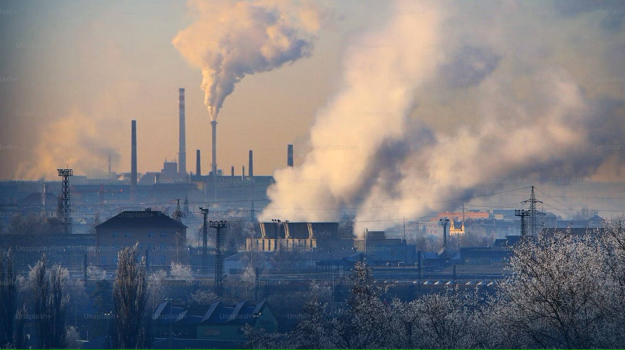
ENVIRONMENTAL POLLUTION
BY HASIBUR RAHMAN MOLLAH

Slide 2
What Is Environment
Environment can be defined as a sum total of all the living and non-living elements and their effects that influence human life.
In simple word, we can say that everything which surrounds us is called environment.

Slide 3

Definition of Environmental Pollution
Environmental pollution is unwarranted disposal of mass or energy into earth’s natural resource pool such as water, land, or air that results in long- or short-term detriment to the atmosphere and its ecological health to negatively impact the living beings and their life both quantitatively and qualitatively (Hussain, 1998).

Slide 4
Types of Pollution
Air Pollution
Water Pollution
Soil Pollution

Slide 5

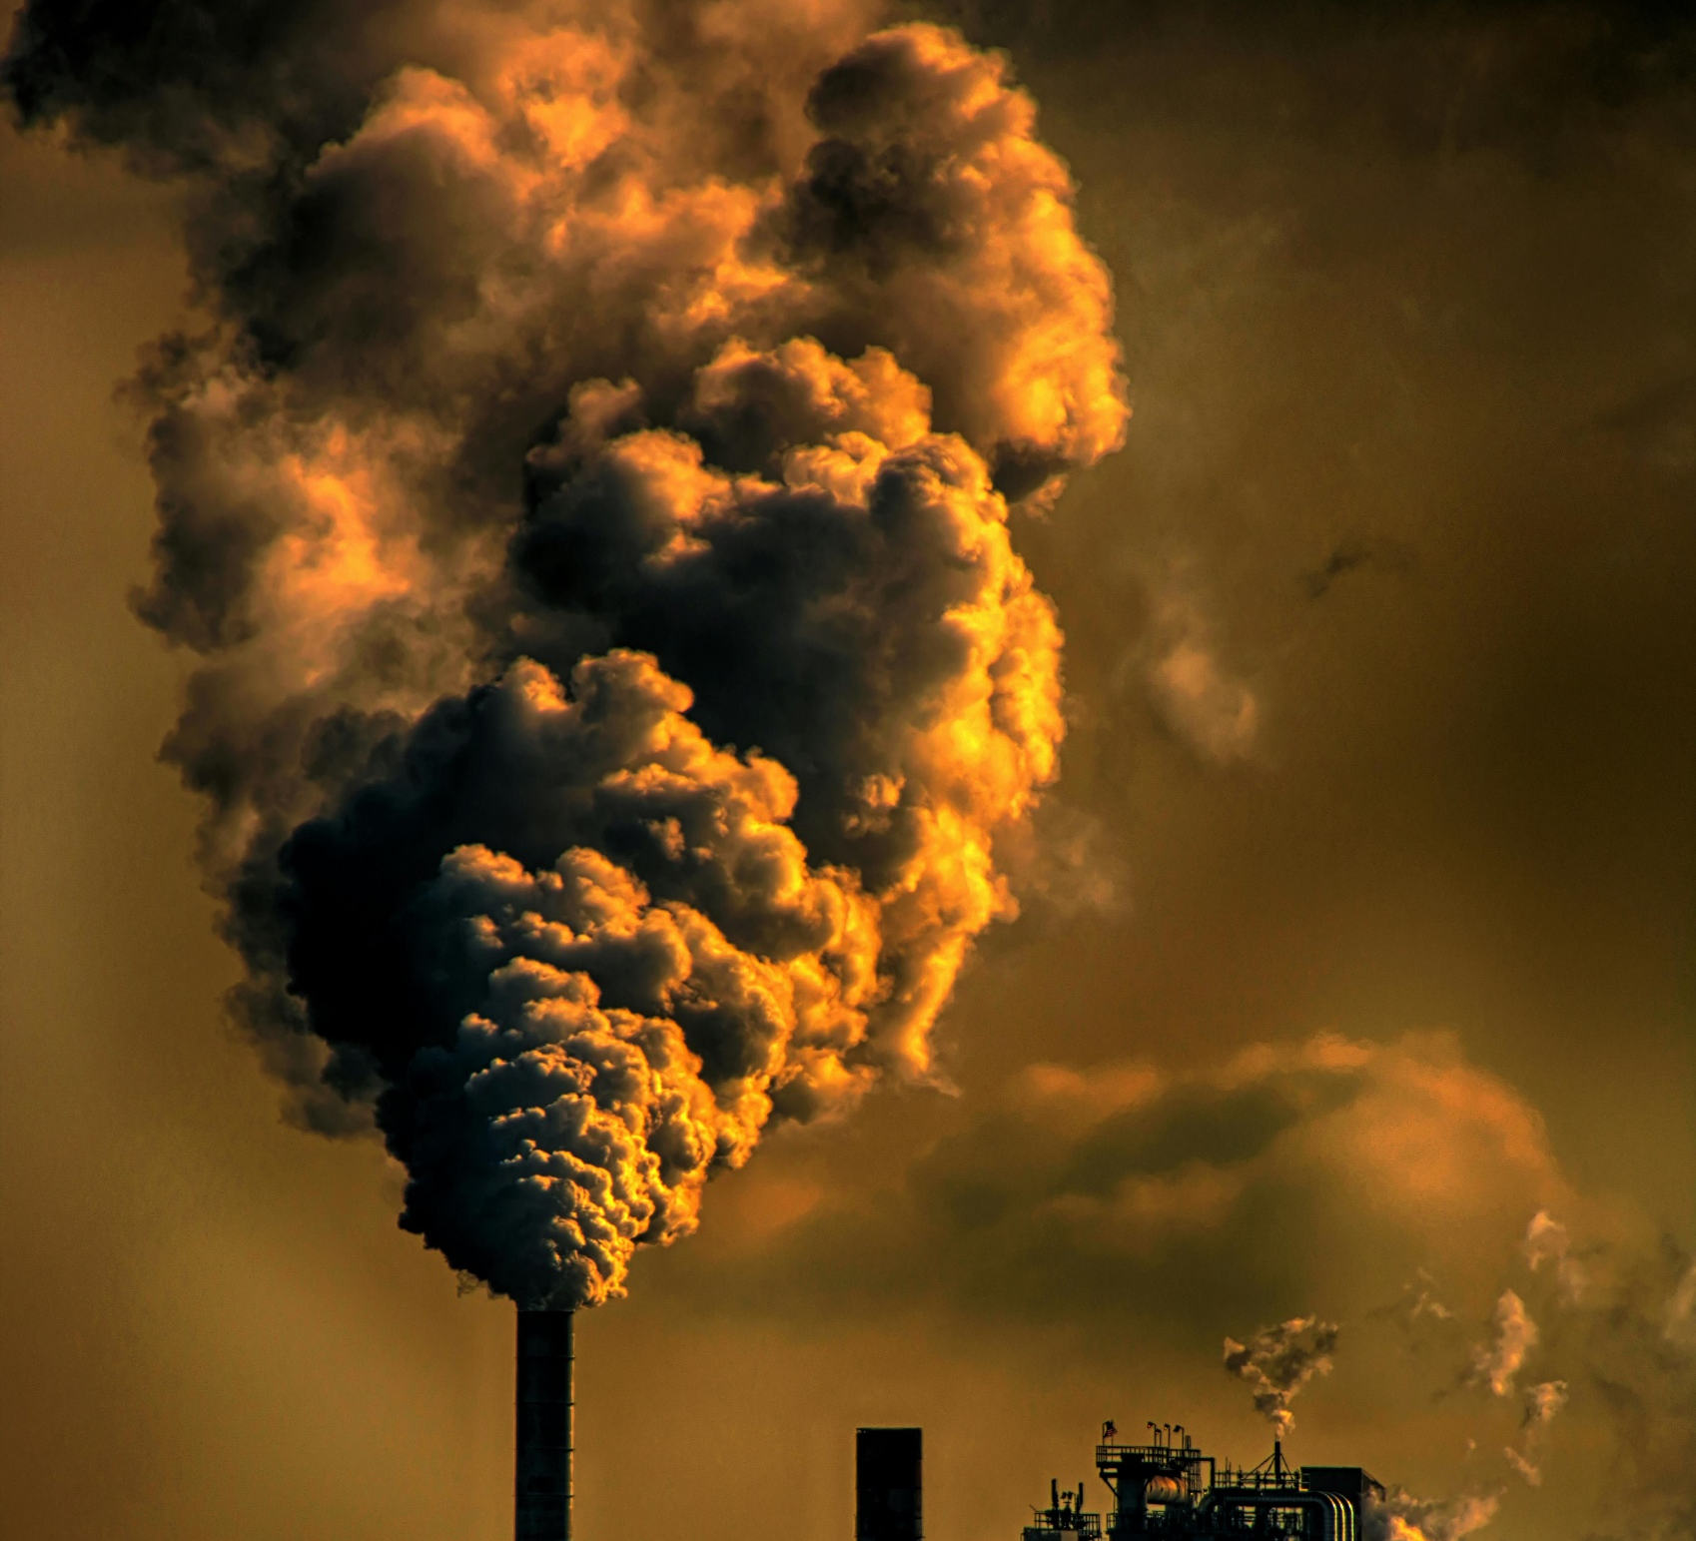



Air Pollution
Air pollution is the contamination of the air by chemicals, physical agents, or biological agents that change the atmosphere's natural characteristics.

Slide 6
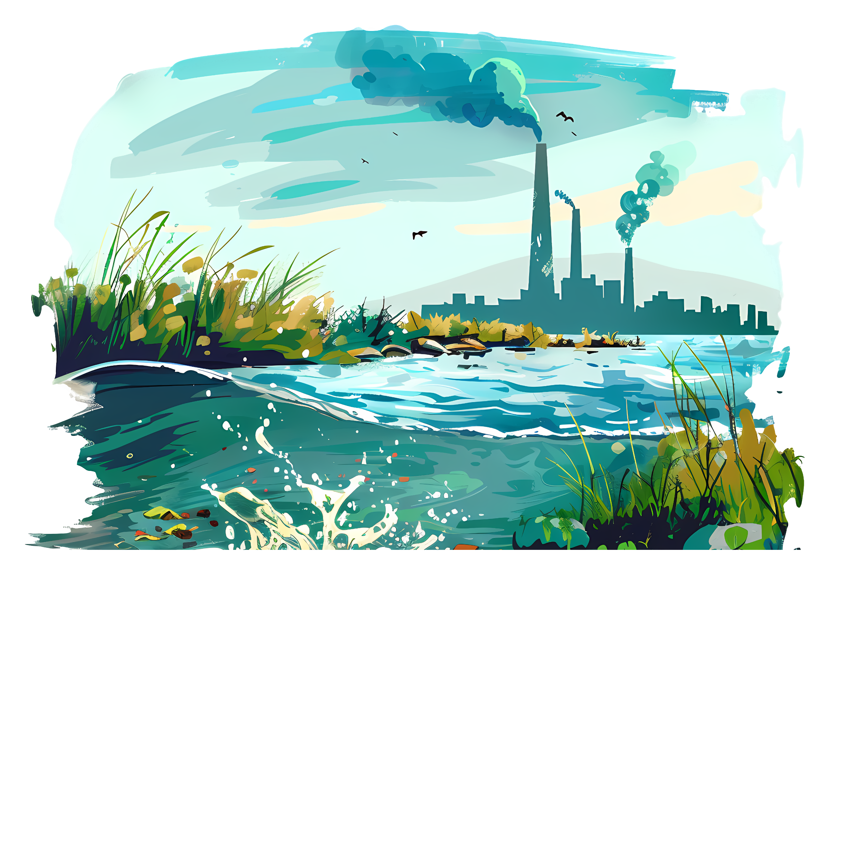
Water Pollution
Water pollution is the release of substances into bodies of water that makes water unsafe for human use and disrupts aquatic ecosystems.

Slide 7
THANK YOU

